Slide 1
Introduction to Spark and GeoSpark
Yijun Lin
Department of Computer Science & Engineering
University of Minnesota, Twin Cities
lin00786@umn.edu
Notes:
Spark, Spark RDD, Spark Framework, Spark SQL, GeoSpark, Spatial SQL

Slide 2
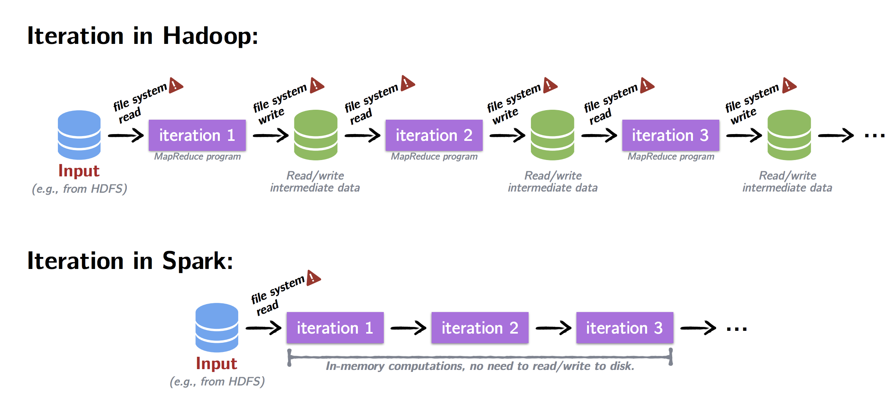
Hadoop MapReduce VS. Apache Spark
Hadoop MapReduce
Typically, data are read from disk, processed, and written back to disk
MapReduce is inefficient for multi-pass applications that read data more than once
Apache Spark
When the output of an operation needs to be fed into another operation, Spark passes the data directly without writing to persistent storage
Notes:
Hadoop MapReduce is great for batch processing where typically data is read from disk, processed and written back to disk. But MapReduce is inefficient for multi-pass applications that read more than once. Performance drops due to data duplication, serialization and disk I/O.

Slide 3
What is Spark
Apache Spark is an open-source cluster computing framework
Application areas
Iterative Algorithms
Interactive Data Mining
Streaming Applications
Spark Stack
Spark Libraries
Core Module
* Resilient Distributed Datasets (RDDs)
Job Schedulers
Data Storage Layer
Notes:
Iterative Algorithms: This includes machine learning algorithms that by nature process data through many iterations.
Interactive Data Mining: Data is loaded into RAM once and then repeatedly queried. Interactive or ad-hoc analysis often includes visualizations. The language for querying the data must also be expressive.
Streaming Applications: For real-time analysis, data must be analyzed as they come into the system. There's a need to maintain aggregate state over time.
This is the architecture of spark stack. From the bottom to top, it contains data storage layer, job scheduler, processing engine and some libraries or modules.
In most situation, Spark is built with Hadoop. It utilizes YARN to allocate and manage cluster resources between master and workers.
Then Spark can access any Hadoop data sources, like HDFS, Hbase and Hive.
Spark Core Module contains basic and general functionality, like resilient distributed datasets, which is known as RDDs. We will describe it in more detail later
On the top of the Spark Stack, It provides some Spark libraries to easily solve user cases with different approaches.
For example, you can use Spark SQL to treat your data just as relational table and directly use SQL syntax.
And you can use Mllib to do machine learning or data mining stuff without implementation by yourselves

Slide 4
Resilient Distributed Datasets (RDDs)
An RDD is an immutable, in-memory collection of objects.
Each RDD can be split into multiple partitions, which in turn are computed on different nodes of the cluster, so that users can
Explicitly persist intermediate results in memory
Control the partitioning to optimize data operations
Manipulate data using a rich set of operators
RDDs seem a lot like Scala collections
RDD[T] and List[T]
Notes:
RDDs are Spark’s distributed collections abstractions and they are really at the core of the spark.
An RDD is an immutable, in-memory collection of objects. Each RDD can be split into multiple partitions,
which in turn are computed on different nodes of the cluster.
RDDs seem a lot like Scala collections, their share almost the same functions like map, flatmap, and filter.
The only difference is that you know that your data is distributed amongst several nodes.

Slide 5
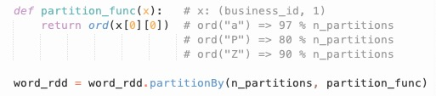
Partitioning Strategy of RDDs
Spark partitioning
Dividing the data into chunks that consider the number of partitions (cluster size) and how data is distributed across partitions.
Number of partitions? Cannot be too large or too small
How are data distributed across partitions?
HashPartitioner will distribute data, e.g., (key, value) pairs, across the partitions using
partitionId = hash(Key) % n_partitions
RangePartitioner will distribute data across partitions based on a specific range
Customized Partitioner
x: (word, 1)
Notes:
If it’s too large, it will produce intense task scheduling.
If it’s too small, there will be a waste on your cluster resources

Slide 6
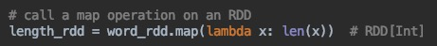
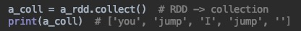
RDD Operations - Transformation VS. Action
Transformation
Return new RDDs as results
They are lazy, the result RDD is not immediately computed
Action
Compute a result based on an RDD, and returned
They are eager, the result is immediately computed
map[T](f: A=>B): RDD[T]
Apply function to each element in the RDD and return an RDD of the result
collect: Array[T]
Return all elements from RDD.

Slide 7
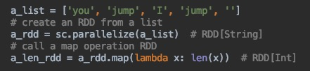
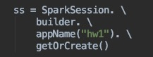
Example
Consider the following example:
What has happened on the cluster at this point?
sc - a SparkContext (or SparkSession) object
The SparkContext object can be thought as your handle to the Spark cluster. It represents the connection between the Spark cluster and your running application. Initializing a SparkContext or SparkSession object is the first step of a Spark program.
Notes:
The SparkContext object can be thought as your handle to the Spark cluster. This is how you talk to Spark. So whenever you start a new Spark job, you gotta create a SparkContext first.
You need to pass some parameters to it to configure your Spark job, like set the application name, define the number of cores and then you can start creating RDDs using this SparkContext.
So let’s look at an example, assume we have a large list of String.
Remember we use parallelize to turn a list into RDD. Here sc is a SparkContxt
And then we compute the length of each string in RDD, that is turn the RDD[String] to RDD[Int]

Slide 8
Example
Consider the following example:
What has happened on the cluster at this point?
Nothing. Execution of map (a transformation) is deferred.
Notes:
The answer is nothing happens. Remember that map is a transformation, it is deferred.
All we get back is a reference to an RDD that does not exist.

Slide 9
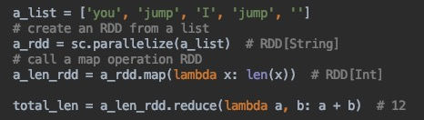
Example (Cont.)
Consider the following example:
Spark starts the execution when an action is called
Return the total number of characters in the entire RDD of strings
reduce(op: (A, A) => A): A
Combine the elements in the RDD together using op function and return result
add an action, reduce
Notes:
we get the total number of characters in the entire RDD of strings
So we can use reduce here, it’s an action and return not another RDD, but a single value like an int.
So this is important to remember. This is probably one of the most common problems that people have when they're just learning Spark.
They wrongly assume that after a map or a filter operation, their computation has been completed.
When in reality, nothing happens on the cluster till invoking some type of action to return a result.

Slide 10
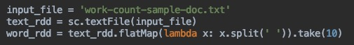
Benefits of Laziness
Another example:
The execution of flatMap is deferred until take action happens
As soon as the first 10 elements of have been computed, word_rdd is done
Spark analyzes and optimizes the chain of operations before executing it
Spark saves time and space by avoiding unnecessary computation

Slide 11
Common Transformations
map | map[T](f: A=>B): RDD[T] Apply function to each element in the RDD and return an RDD of the result.
flatmap | flatmap[T](f: A=>B): RDD[T] Apply function to each element in the RDD and return an RDD of the result, but output is flattened.
filter | filter[T](pred: A=>Boolean): RDD[T] Apply predicate function, pred, to each element in the RDD and return an RDD of elements that passed the condition.
distinct | distinct():RDD[T] Return an RDD with duplicates removed

Slide 12
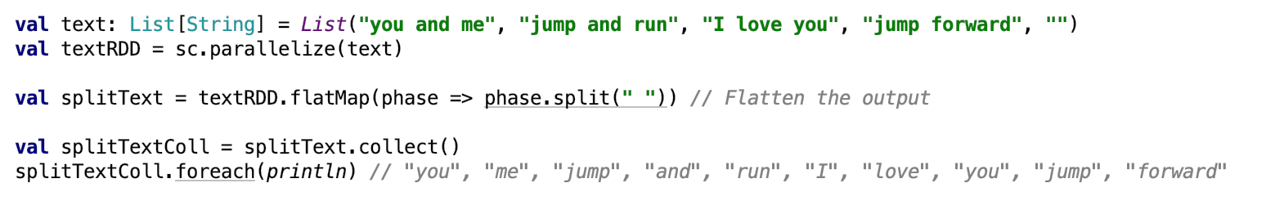
Common Transformations
flatmap | flatmap[T](f: A=>B): RDD[T] Apply function to each element in the RDD and return an RDD of the result, but output is flattened.

Slide 13
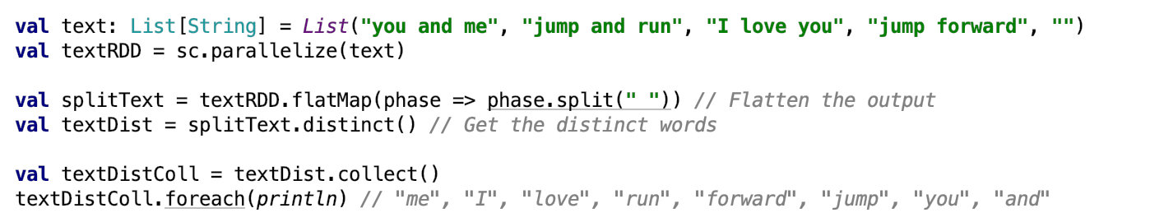
Common Transformations
distinct | distinct():RDD[T] Return an RDD with duplicates removed

Slide 14
Common Actions
collect | collect: Array[T] Return all elements from RDD.
count | count(): Long Return the number of elements in the RDD.
take | take(num: Int): Array[T] Return the first num elements of the RDD.
reduce | reduce(op: (A, A) => A): A Combine the elements in the RDD together using op function and return result.
foreach | foreach(f: A => Unit): Unit Apply function to each element in the RDD, and return Unit.

Slide 15
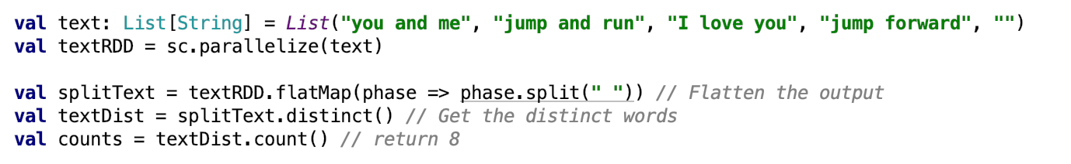
Common Actions
count | count(): Long Return the number of elements in the RDD.

Slide 16
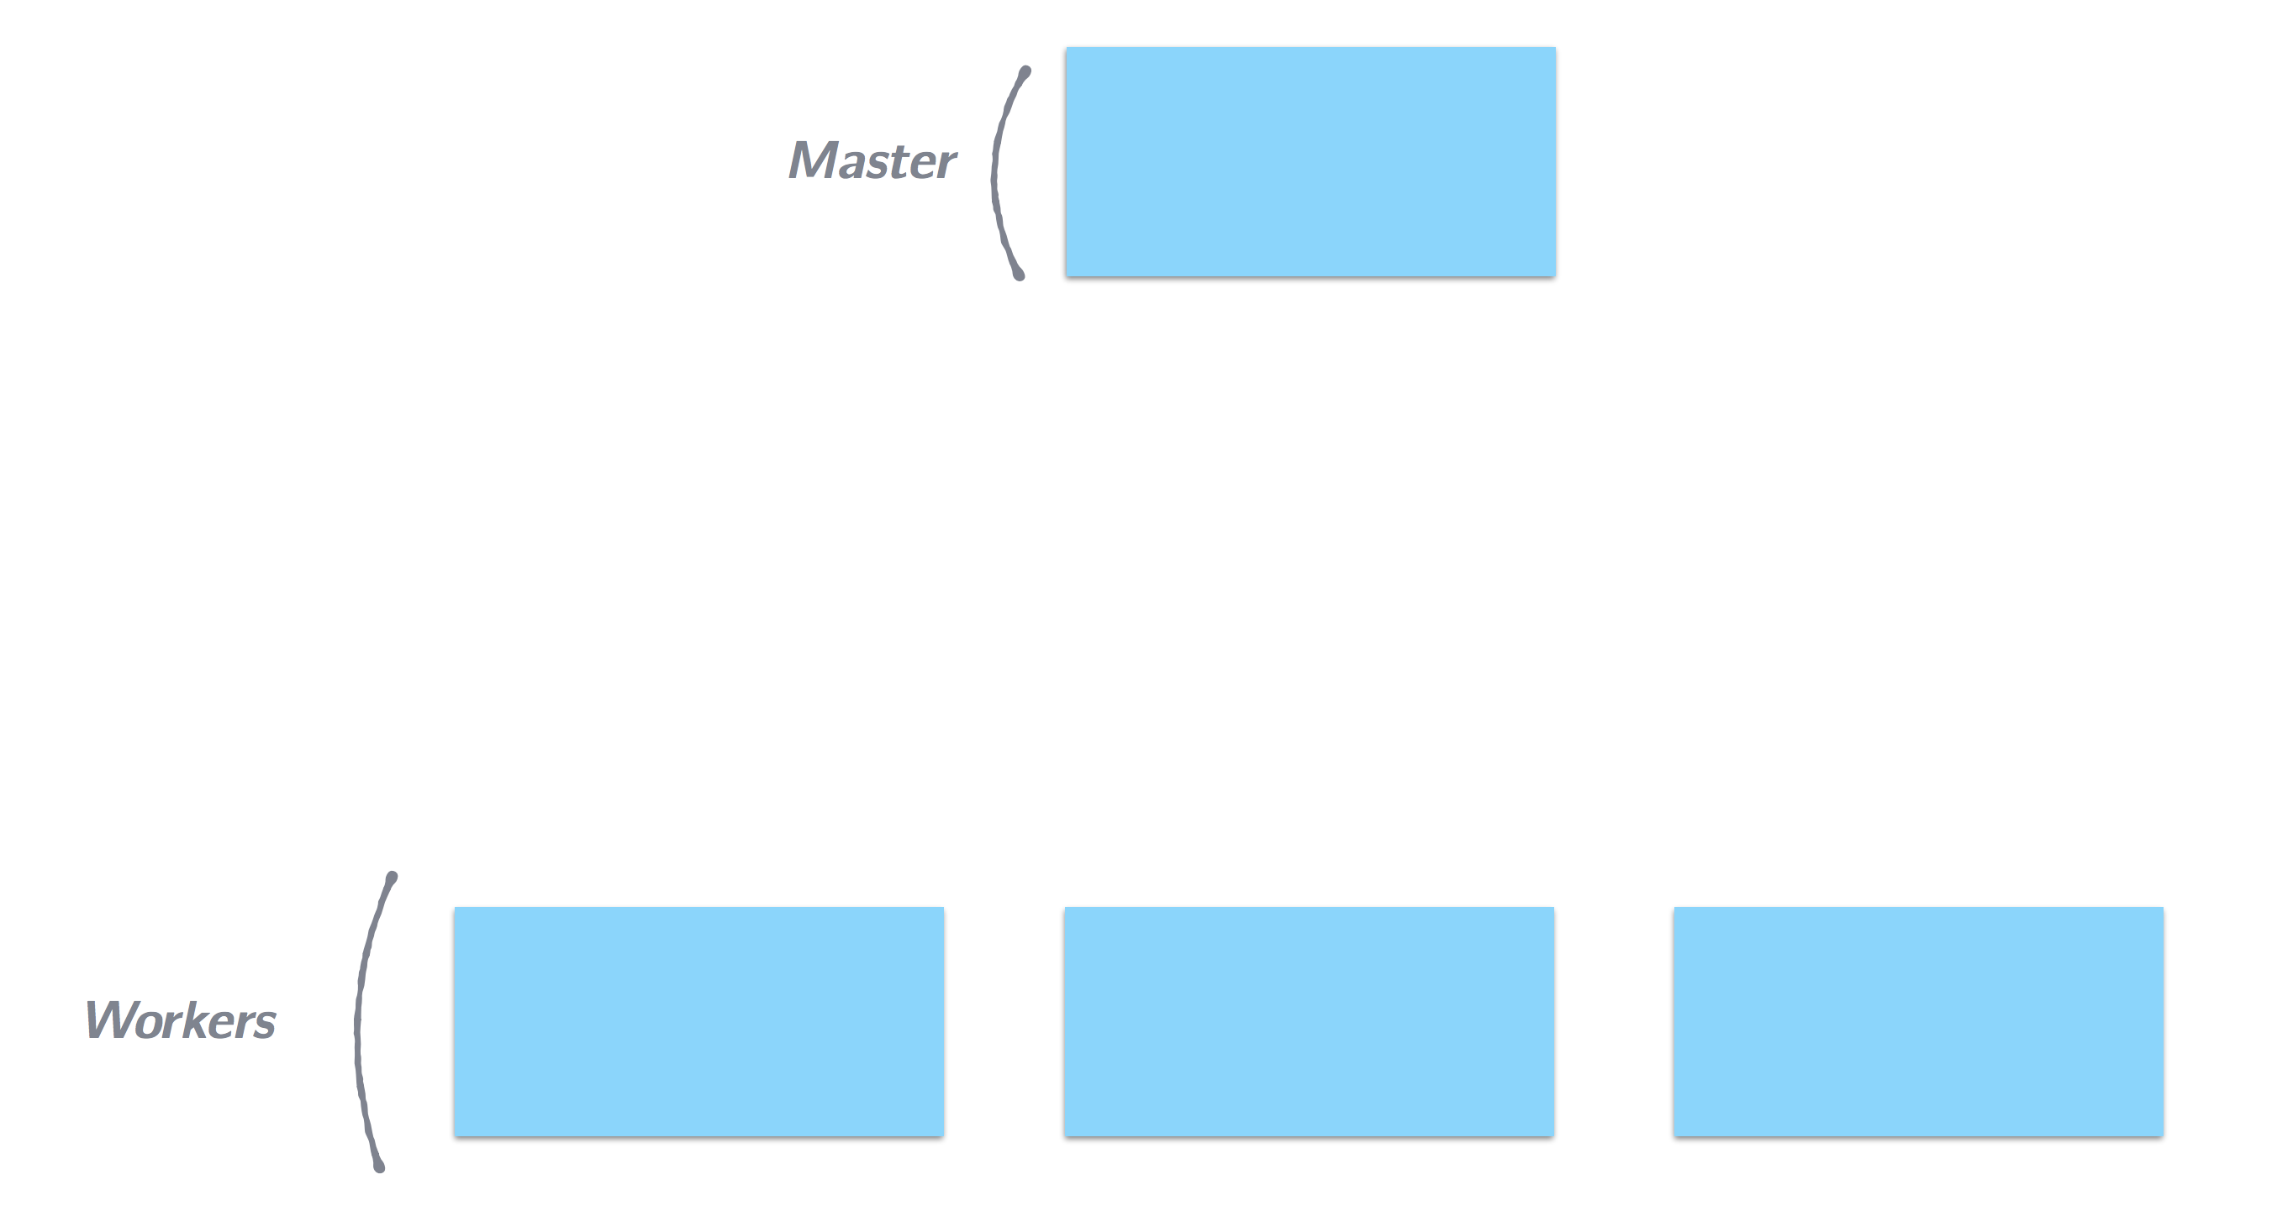
How Spark Jobs are Executed
Notes:
Spark is organized as a master-worker topology. Usually there’s one master and many workers

Slide 17
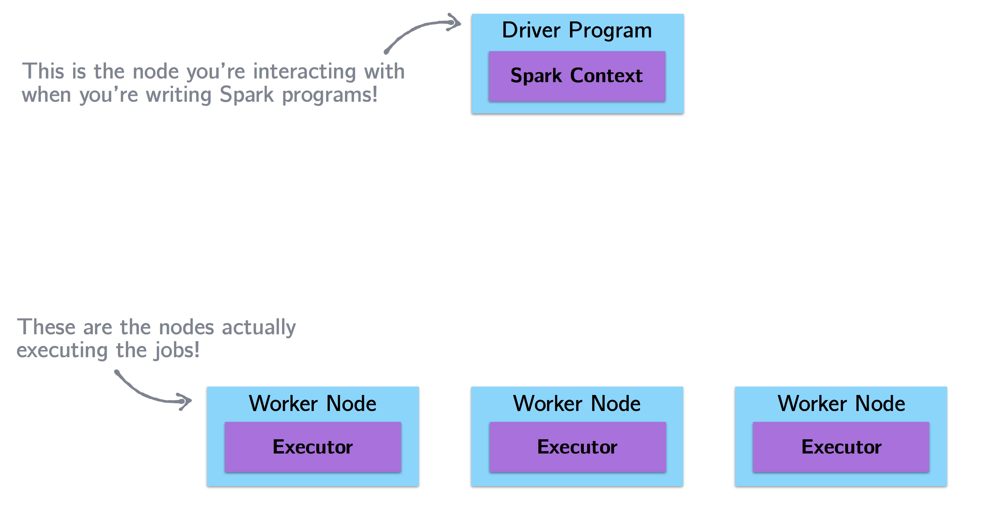
How Spark Jobs are Executed
Notes:
In the context of a spark program. we refer to the master as the driver program. and refer to the workers as worker nodes.
Now the driver program is where the spark context is. So when you write a spark program, you think as if you were the driver node and you are giving commands to worker nodes.

Slide 18
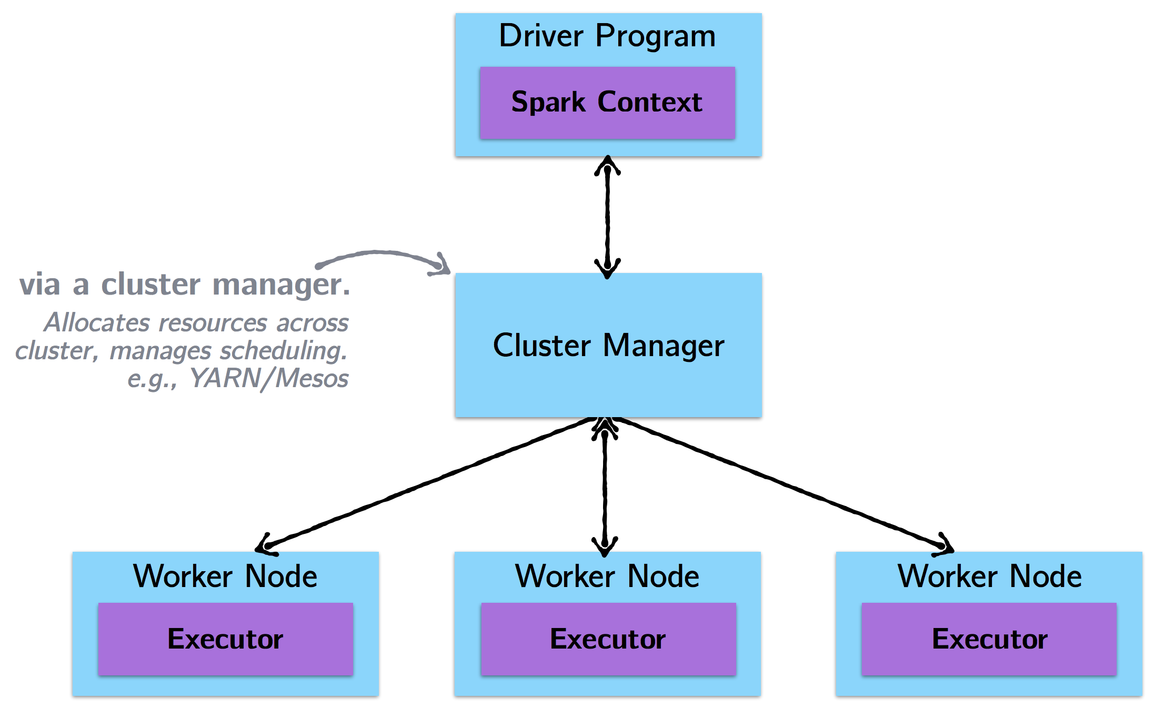
How Spark Jobs are Executed

Slide 19
How Spark Jobs are Executed
Steps of executing a Spark program:
The driver program runs the Spark application, which creates a SparkContext
The SparkContext connects to a cluster manager to allocate resources
Spark acquires executors on nodes in the cluster, which run computations for your application.
Driver program sends your application code to executors to execute.

Slide 20
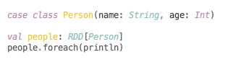
Example
A simple example with println (Scala code)
What will you see?
foreach(f: A => Unit): Unit
Apply function to each element in the RDD and return Unit

Slide 21
Example
A simple example with println (Scala code)
On the driver: Nothing.
The operation foreach is an action, with return type Unit.
Therefore, it is eagerly executed on the executors, not the driver. Thus, println are happening on the worker nodes and return nothing to the driver node.
foreach(f: A => Unit): Unit
Apply function to each element in the RDD and return Unit

Slide 22
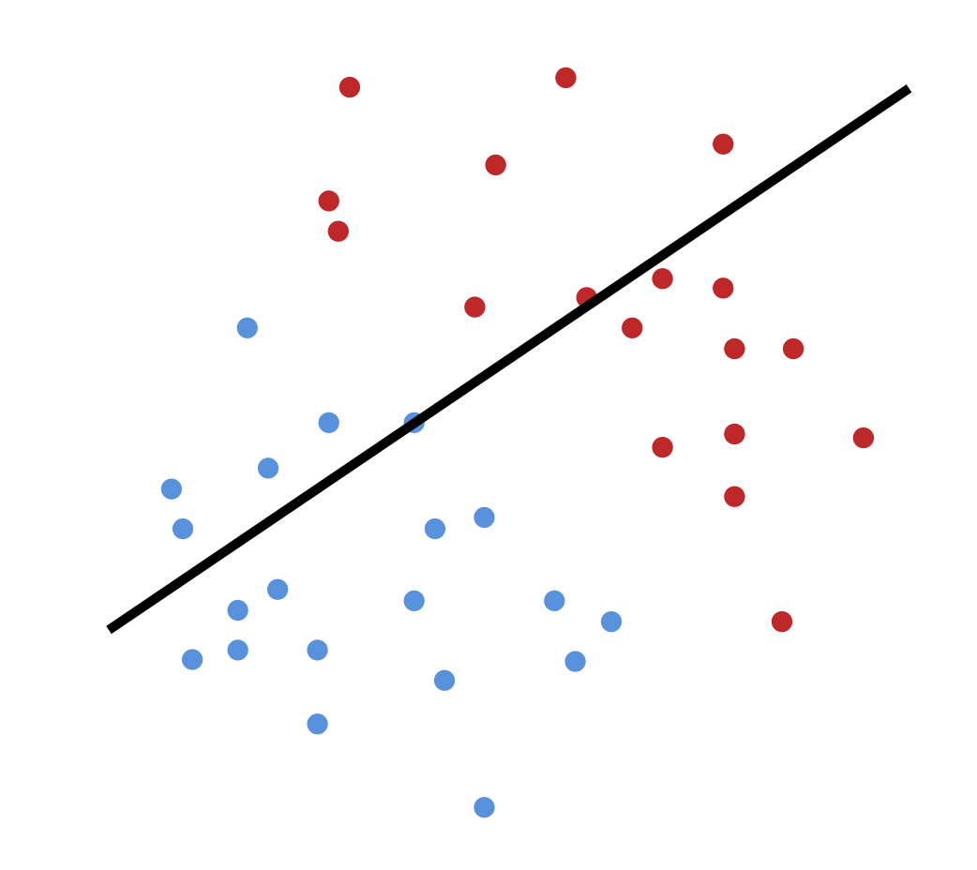
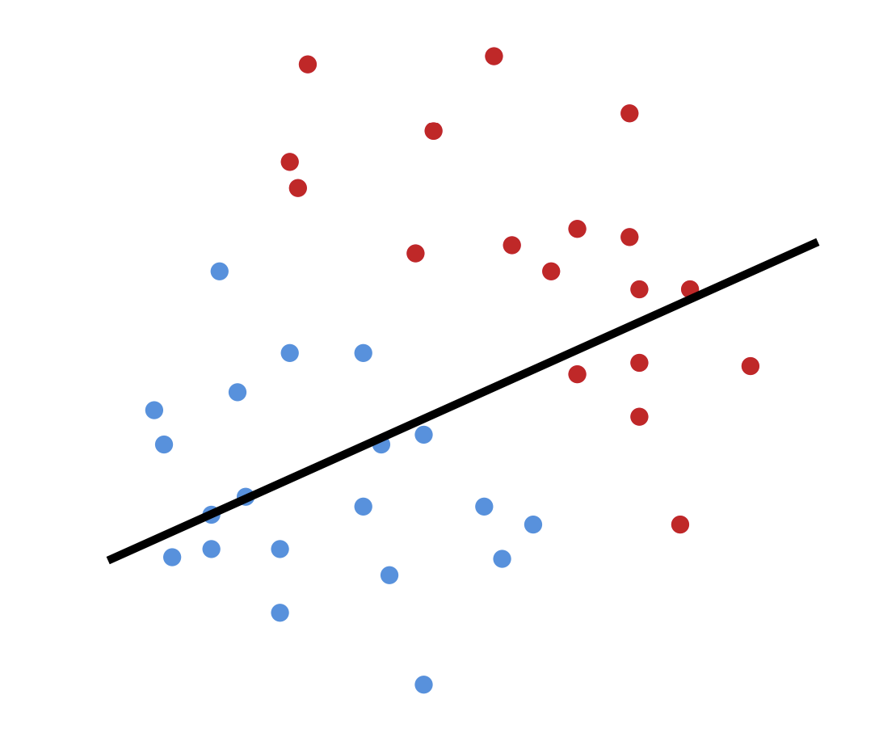
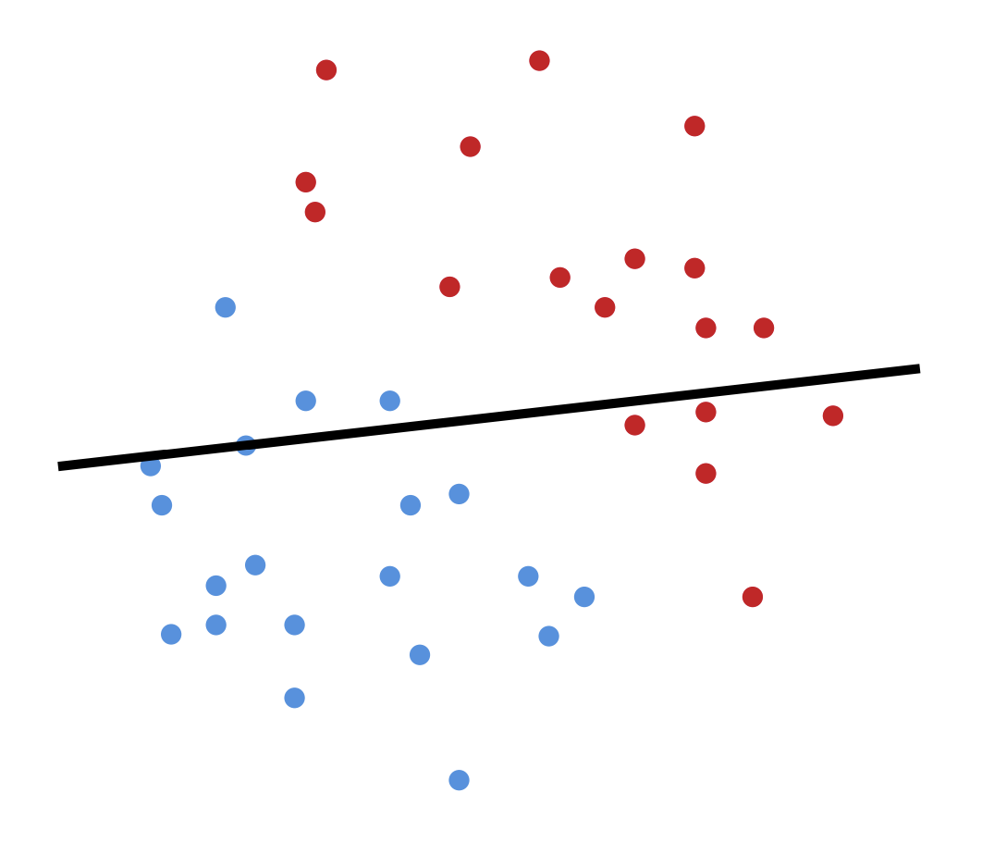
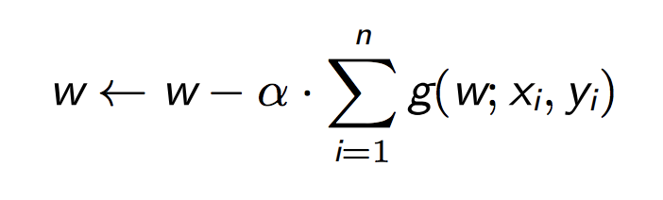
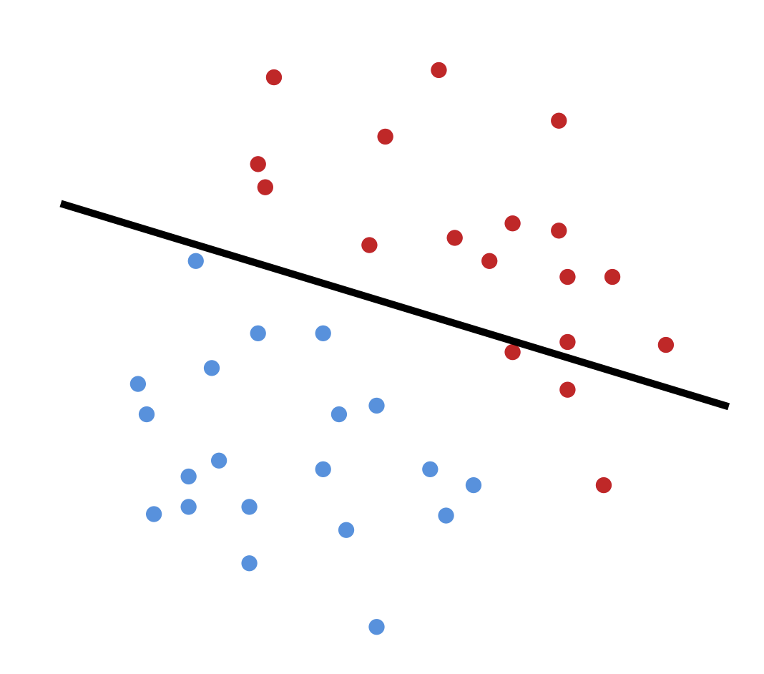
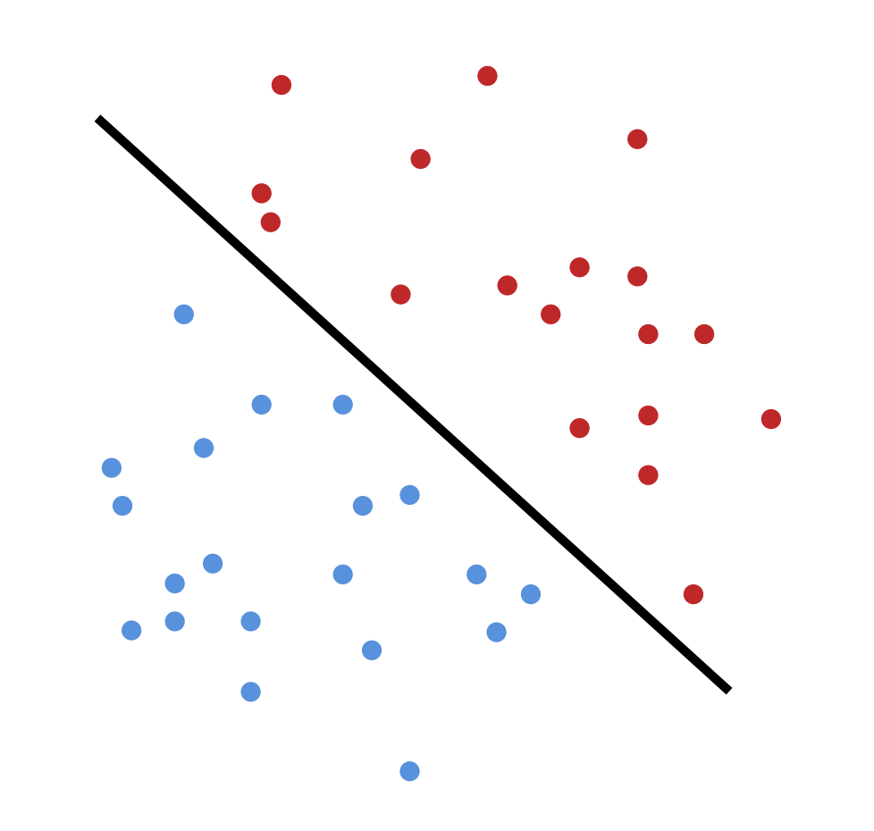
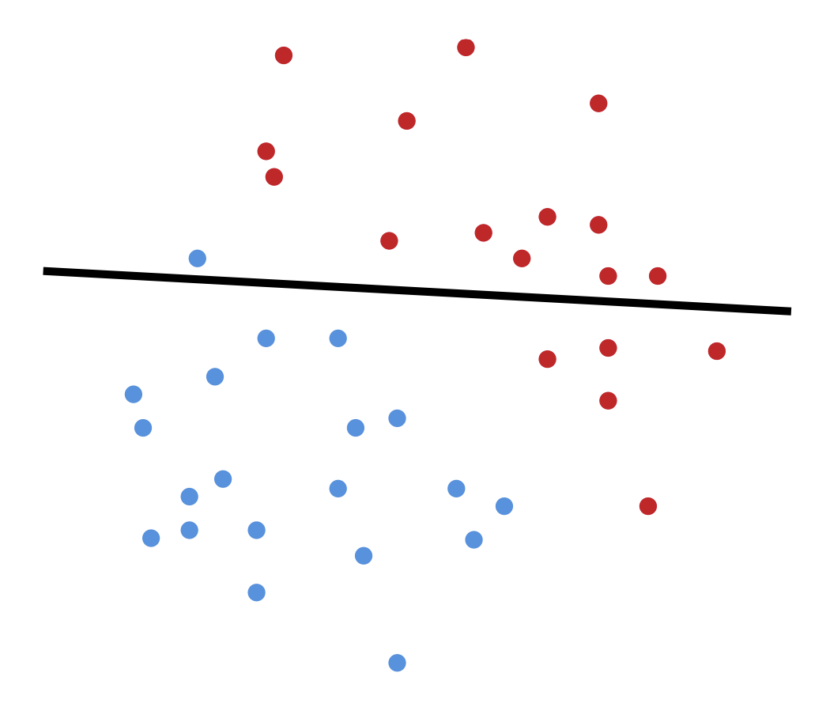
Programming with Spark
Example: Logistic Regression
Logistic regression is an iterative algorithm typically used for classification. Like most classification algorithms, it updates weights iteratively based on the training data.

Slide 23
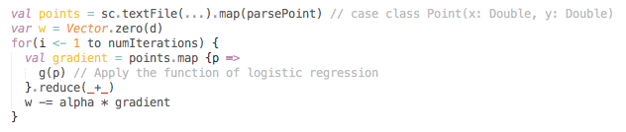
Programming with Spark
Example: Logistic Regression
Logistic regression is an iterative algorithm typically used for classification. Like most classification algorithms, it updates weights iteratively based on the training data.

Slide 24
Programming with Spark
Example: Logistic Regression
Logistic regression is an iterative algorithm typically used for classification. Like most classification algorithms, it updates weights iteratively based on the training data.
Spark starts the execution when the action reduce is applied

Slide 25
Programming with Spark
Example: Logistic Regression
Logistic regression is an iterative algorithm typically used for classification. Like most classification algorithms, it updates weights iteratively based on the training data.
points is being re-loaded upon every iteration!
Unnecessary!

Slide 26
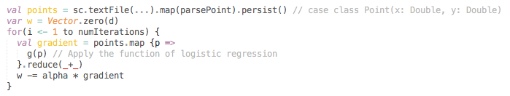
Caching and Persistence
By default, RDDs are recomputed each time you run an action on them. This can be expensive (time-consuming) if you need to use a dataset more than once.
Spark allows you to control what is cached in memory
persist() or cache()
points is loaded once and is cached in memory.
It can be re-used on each iteration.

Slide 27
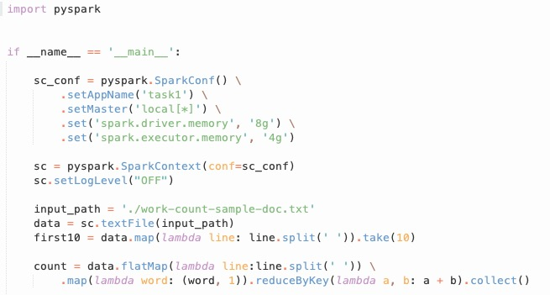
Word Count Example Using Spark RDD

Slide 28
Spark SQL
Spark SQL is a component of Spark Stack
A Spark module for structured data processing
Implemented as a library on top of Spark
Advantages
Support relational processing in spark
High performance
Easily support new data sources such as semi-structured data
Notes:
Spark SQL is very easy to use.
I remember that when I did the recommendation system competition, I used Spark SQL in my system and it is easier to logically understand the whole process.
It is a spark module for structured data processing or sort of doing relational queries and it is implemented as a library on the top of the spark.
There are three main goals for Spark SQL.
The first is to support relational processing in spark. So you can imagine selecting an entire column of the structured data is easier to do in a single line in a SQL statement than it is to do somehow with Map or a filter operation.
The second goal is high performance that previous mentioned.
The last is to get data more easily into Spark. It would be nice to just read in semi-structured data like JSON, for example

Slide 29
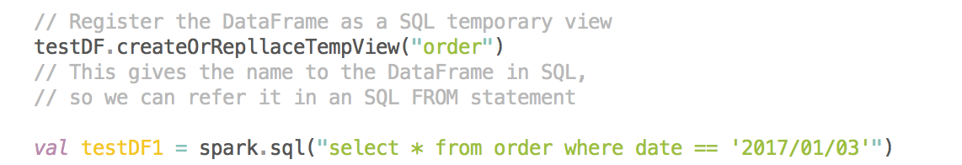
Spark SQL - DataFrame
order_id | account | date
1 | aaa | 2017/01/01
2 | bbb | 2017/01/02
3 | ccc | 2017/01/02
4 | ddd | 2017/01/03
5 | eee | 2017/01/03
DataFrame is the core abstraction of Spark SQL
Conceptually, RDDs are full of records with some known schema
DataFrame is like a table in relational database
Once you have a DataFrame to operate on, you can freely write familiar SQL syntax to operate on your dataset!

Slide 30
Managing Spatial Data in Spark
Classic - single machine DBMS or GIS tools
ArcGIS/QGIS
PostgreSQL + PostGIS
Managing spatial data is not easy in Spark
No spatial data type support
No spatial index
No spatial query

Slide 31



Managing Spatial Data in Spark
Classic - single machine DBMS or GIS tools
ArcGIS/QGIS
PostgreSQL + PostGIS
Managing spatial data is not easy in Spark
No spatial data type support
No spatial index
No spatial query
+

Slide 32
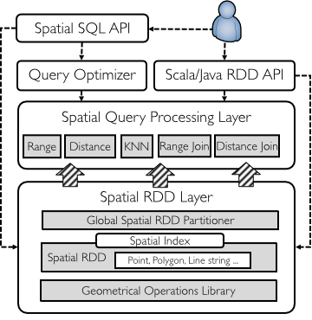
Apache Sedona (GeoSpark)
GeoSpark is a cluster computing system for processing large-scale spatial data
GeoSpark extends RDDs to Spatial Resilient Distributed Datasets (SRDDs) that efficiently load, process, and analyze large-scale spatial data across machines
Spark SQL => Spatial SQL
Examples: https://jiayuasu.github.io/files/talk/jia-sigspatial19-teaser.pdf

Slide 33
Spatial RDD (SRDD) Layer
SRDD supports heterogeneous data sources
E.g., CSV, WKT, GeoJSON, NetCDF/HDF, and Shapefile
SRDD partitioning
GeoSpark automatically repartitions a loaded Spatial RDD according to its internal spatial data distribution
The intuition is to group spatial objects into the same partition based on the spatial proximity, so that reducing the data shuffles across cluster
Yu et al. Spatial data management in apache spark: the GeoSpark perspective and beyond, 2018
Notes:
Apache Spark loads the input data file into memory, physically splits its in-memory copy to many equally sized partitions (using hash partitioning or following HDFS partitioned file structure) and passes each partition to each worker node. This partitioning method doesn’t preserve the spatial proximity which is crucial for improving query speed.

Slide 34
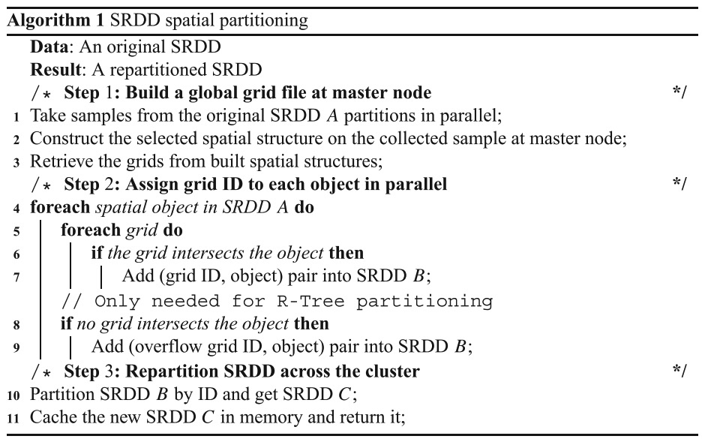
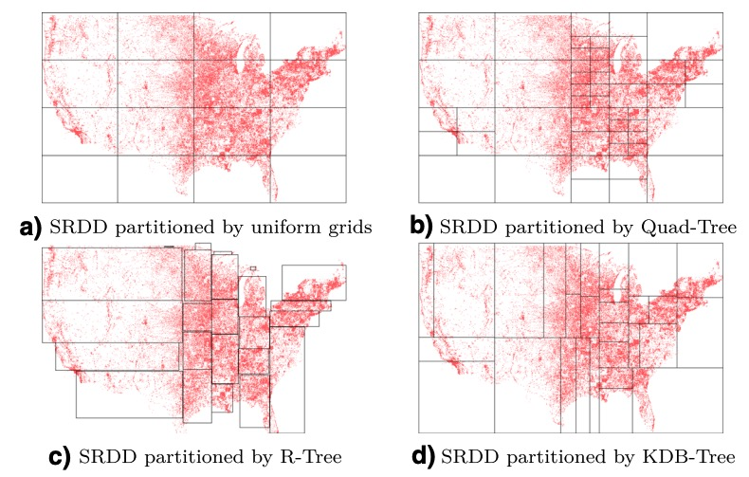
SRDD Partitioning
Yu et al. Spatial data management in apache spark: the GeoSpark perspective and beyond, 2018
Notes:
The key idea of the data structure is to group nearby objects and represent them with their minimum bounding rectangle in the next higher level of the tree; the "R" in R-tree is for rectangle.
A quadtree is a tree data structure in which each internal node has exactly four children.

Slide 35
Building Local Indexes
Building a spatial index for the entire dataset is not possible because a tree-like spatial index yields additional 15% storage overhead
If the user wants to use a spatial index, GeoSpark will build a set of local spatial indexes rather than a single global index
Create a spatial index (R-Tree or Quad-Tree) per RDD partition
Local indexes can be persisted in memory or disk

Slide 36
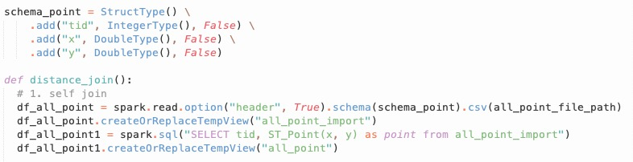
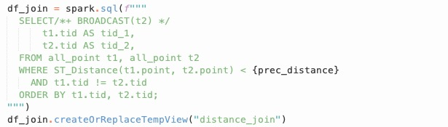
Spatial SQL Example
Other examples: https://sedona.apache.org/tutorial/sql-python/

Slide 37
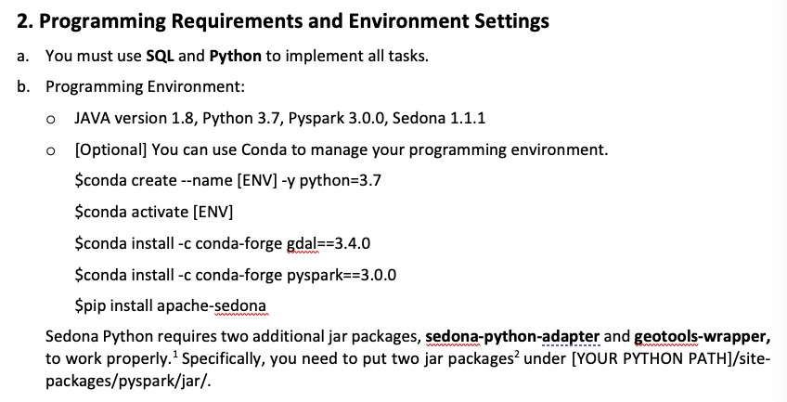
Assignment 1

